Slide 1
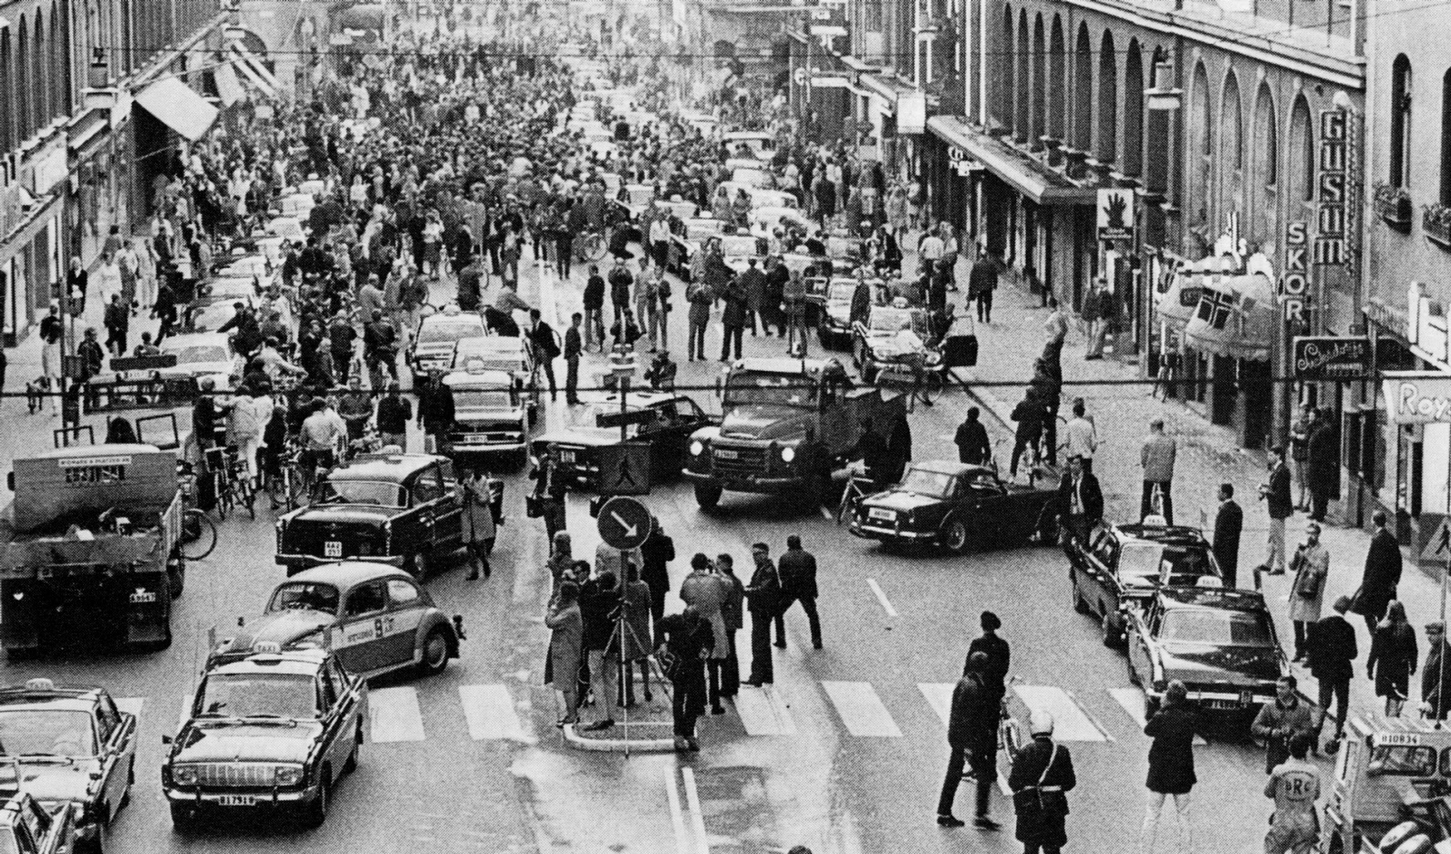
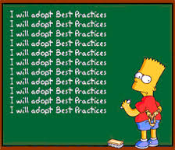
ISO/TC211 Best practices for UML modelling
Knut Jetlund
Norwegian Public Roads Administration
knut.jetlund@vegvesen.no
Twitter: @Jetgeo
GitHub: https://github.com/jetgeo
Notes:
Thank you.
I like to start my standarization presentations with this picture. As some of you probably recognize, it is from Stockholm on the day when Sweden changed from left side driving to right side driving. I would say that this was a result of best practice, but there may be some of you who think that left side driving is a better practice. Anyway, it is definitively a matter of standardization.

Slide 2

Knut Jetlund
Who am I?
Geographic information in the Norwegian Public Roads Administration
Norwegian Road Database (NVDB)
ISO TC/211
Convenor of ISO/TC 211 AHG on Best Practices for UML
Norwegian SOSI standard
INSPIRE
Special interest in
Maps
Structure and automation in general
UML models and Enterprise Architect
Data transformations in FME
Notes:
Just a few words about myself, and why I am here.
My daily work is with geograpic information in the Norwegian Public Roads Administration. But right now, I am here as convenor of the ISO/TC211 on best practices for UML.
Prior to this role, I have been working with ISO/TC211 standards for 5 years, in particlar with
19157 - Data quality
19115 - Metadata
19160 - Addressing
(I am also a part of the project team on 19107 - Spatial Schema)
I am working quite a lot with the Norwegian SOSI standard, and on delivering data from our road database to INSPIRE TN.
I guess a special interest in stucture and automation in general is the reason why I ended up working within this field.

Slide 3
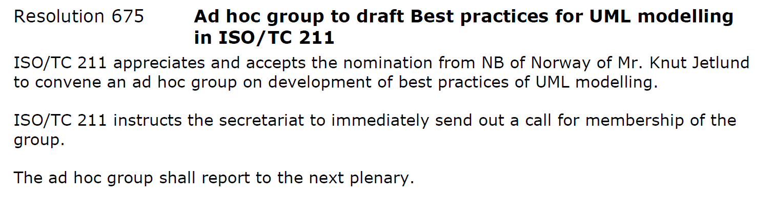
Best practices for UML modelling
ISO/TC211 Ad hoc group
Resolution at the plenary meeting in Berlin in June 2014
First working group meeting was held during the meeting week in Shenzhen, China in November 2014
20 experts from around the world
Notes:
The AHG on BP for UML modelling was established last year, through a resolution at the ISO/TC211 plenary meeting in Berlin in June. We had our first working group meeting in China in November, during the ISO/TC211 meeting week. A total of 20 experts from around the world have joined the group, either through nomination or on request. Some of them are here: Clemens Prortelle, Markus Steifert, Heidy Vanparys, Paul Scarponcini, maybe others as well?

Slide 4

Best practices for UML modelling
ISO/TC211 Ad hoc group
Vision:
UML models shall be understood by both humans and machines
Notes:
The reason we all are here, is that data modelling in UML has become a fundamental part of standardization of geographic information, both for the ISO/TC211 core standards and for domain modelling in INSPIRE and national SDIs.
The models fulfil (at least) two different needs: Documentation for human understanding, and schemas for implementation in GML, Web services etc. Many modelling rules are described in several different ISO/TC211 standards, such as 19103 (Conceptual schema language), 19109 (Rules for application schema) and 19136 (GML - Annex E).
The main focus in these rules are machine readable models for implementation, while human readability is more of an issue for best practices. The ISO/TC211 has experienced through their own work on standardization that there is a need to collect and describe rules and best practices in a structured way, to make sure both the core standards and the domain models are created and maintained to fulfil demands for both human understanding and for model driven implementation.
And this is the vision for the AHG: That UML models shall be understood by both humans and machines.

Slide 5


Best practices for UML modelling
ISO/TC211 Ad hoc group
Audience:
Domain experts
Model experts
ISO/TC211
OGC
INSPIRE
National SDIs
Notes:
There are a number of different audiences to consider:
Domain experts: Many domain experts are included in the modelling work. They need help both to understand UML models, and not at least to create models for their domain in a good manner.
Also, model experts need some guidance to create models following the rules and recomendations in ISO/TC211 standards, and to present them in a understandable way.
And, as the interest for this workshop shows, there are a lot of different communities working with UML modelling of geographic information: ISO/TC211, OGC, regional SDIs like INSPIRE, and national SDIs to mention a few.

Slide 6
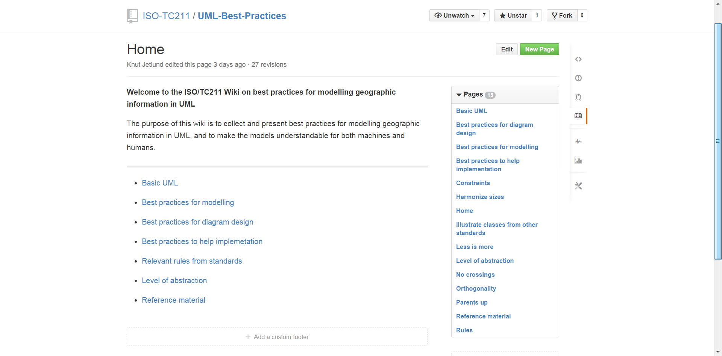
The outcome of the work will be a wiki for modelling geographic information in UML, and will be freely available.
https://github.com/ISO-TC211/UML-Best-Practices/wiki
At an early stage of development
Notes:
Already at the meeting in Berlin, before the group was established, we discussed how the results should be presented. There was a broad agreement that the result should be presented as some kind of a wiki, and that it should be freely available.
We have been discussing different possible wikis, including the OGC Portal, which we were given an oportunity to use. We concluded that the wiki should be presented as an ISO/TC211 work, but the ISO/TC211 currently don’t have a portal with wiki functionality. So we ended up using the wiki functionality on GitHub for now. But this is just a preliminary sollution, and hopefully, we will move the wiki to a more offical ISO/TC211 site in the future.

Slide 7
Main focus on
Modelling
Diagram design
Prepare for implementation
Follow rules from standards
Notes:
In the BP work, we are focusing on four main subjects, and I will describe more details for them later:
Best practices for modelling – for machine readability
Best practices for diagram design – for human readability
Best practices to prepare the models for implementation
Relevant rules from strandards – wrapped into the other main subjects
In addition, we wil also have a topic on basic UML, and a description of the different levels of abstraction and the terminology related to them. Conceptual models, application schemas, implementation models and more.

Slide 8
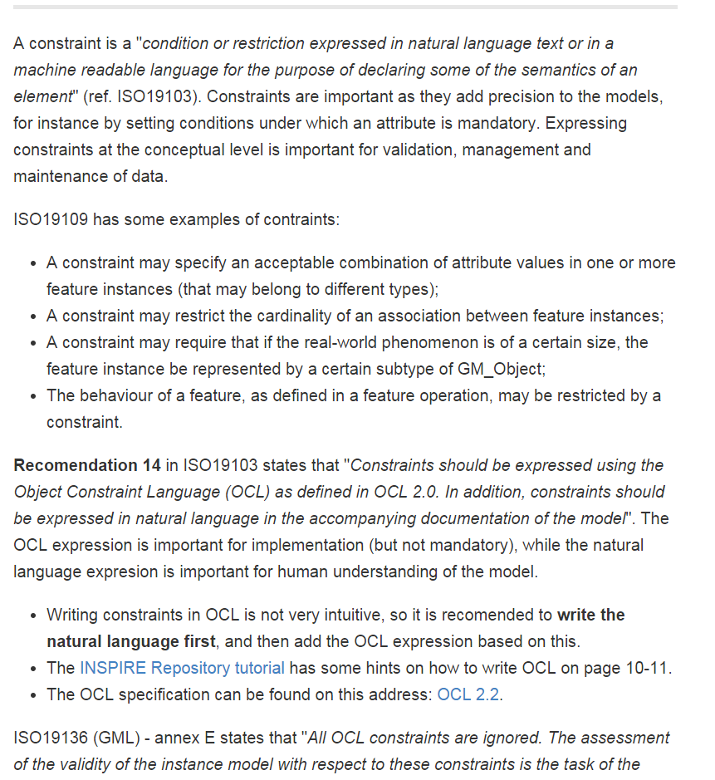
https://github.com/ISO-TC211/UML-Best-Practices/wiki/Constraints
Rules and recommendations in standards
19103 - Conceptual schema language
19109 - Rules for application schema
19136 - GML (Annex E)
19139 - XML Schema Implementation
Notes:
There are a lot of rules and recomendations for models, wrapped into ISO/TC211 standards:
19103
19109
19136
19139
In addition, for instance INSPIRE have some rules and recomendations in their generic conceptual model and other documents.
In the BP work, the rules and recomendations from different standards and other documents are collected and put into a practical setting. It is important to say that we are not rewriting the standards, just collecting and presenting rules and recomendations in a practical setting. People will still have to buy the standards to check if their models follow the conformace tests.
This slide shows an example of how a recomendation from 19103 is presented in a BP setting: How to write constraints. 19103 recomend that they should be expressed in OCL, and in a natural language in addition. This recomandation is further explained on the wiki, where we recomend to write the natural language first, and then translate into OCL. Writing OCL is not very intuitive.

Slide 9
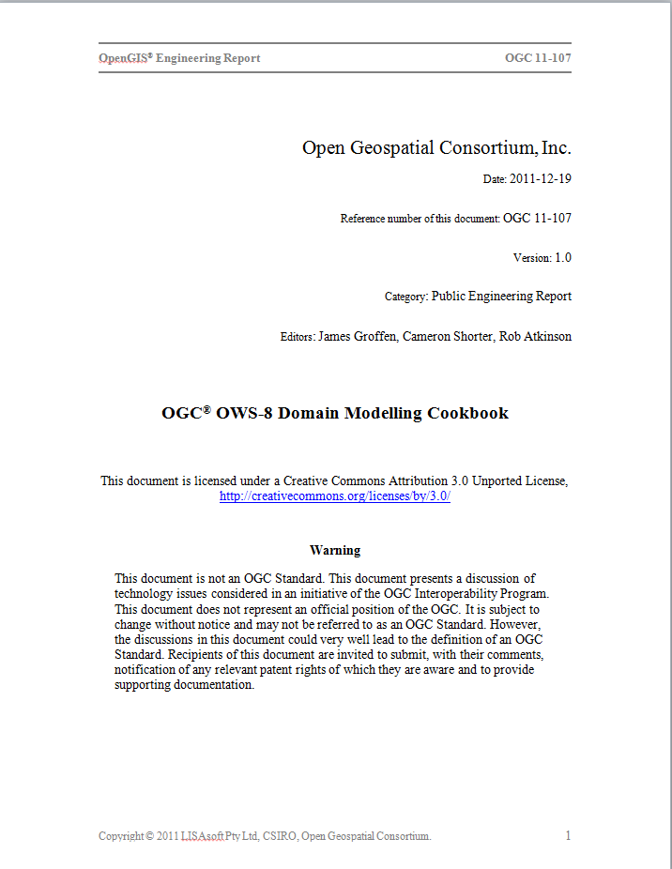
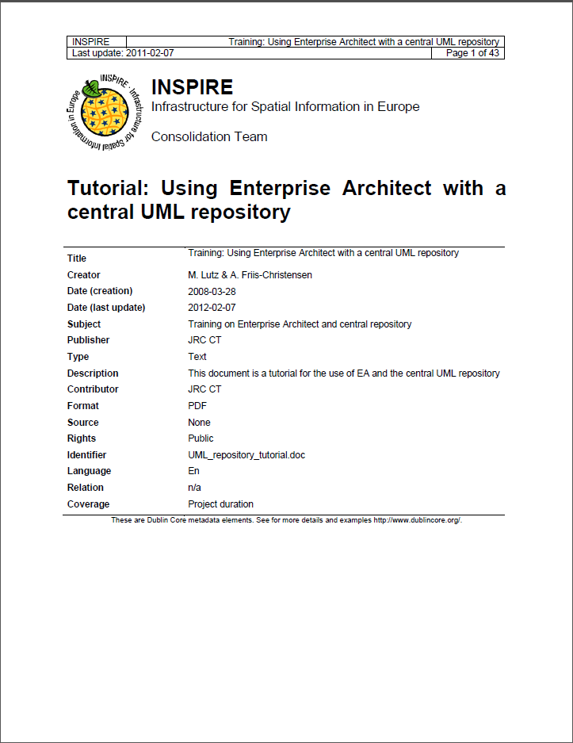
Other references
OGC Domain Modelling Cookbook
INSPIRE Repository tutorial
https://github.com/ISO-TC211/UML-Best-Practices/wiki/Reference-material
Notes:
In addition to the rules and recomendations in standards, there are a number of documents that describe some best practices. The OGC started working on a domain modelling cookbook some years ago. It seems like this work stopped at some point, before the cookbook was finished. But the document has some best practices and descriptions that are really relevant for our BP work.
Also, INSPIRE has a tutorial on how to use EA and the subersion repository. This document also describes some basic rules for how to create models, how to illustrate constraints, and more.
The relevant documents are linked to from the wiki, and some of the descriptions are or will be adopted into the wiki pages.

Slide 10
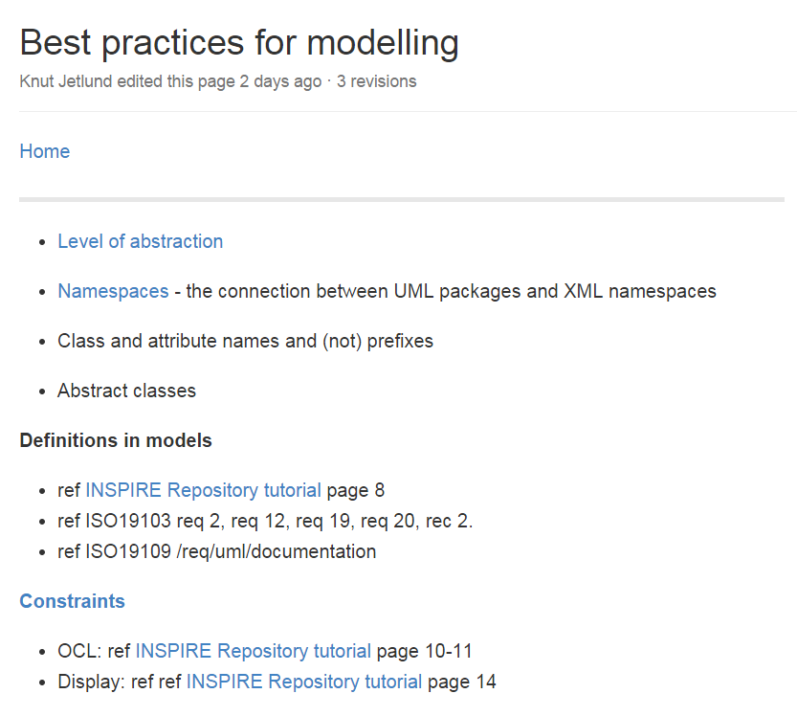
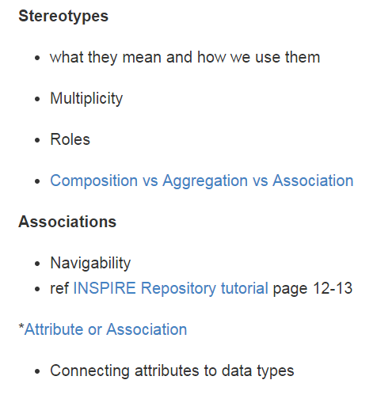
Modelling
Prepare for implementation
Prepare for documentation
https://github.com/ISO-TC211/UML-Best-Practices/wiki/Best-practices-for-modelling
Notes:
The best practices descriptions for modelling will focus on creating models that are prepared for implementation, and also for generating documentation. At this stage, the page is just a collection of notes.
Some topics that are likely to be described on this page and its subpages are
Class and attribute names. Rules and recommendations for them. No special characters, why we don’t need prefixes any more, upper and lower camelcase and more
Abstract classes – the concept and how to model them
Writing definitions
Contraints – ref previous slides
How to use stereotypes
Associations and attributes
Subclasses or “type” attributes
And more! This is just the preliminary notes for this page.

Slide 11
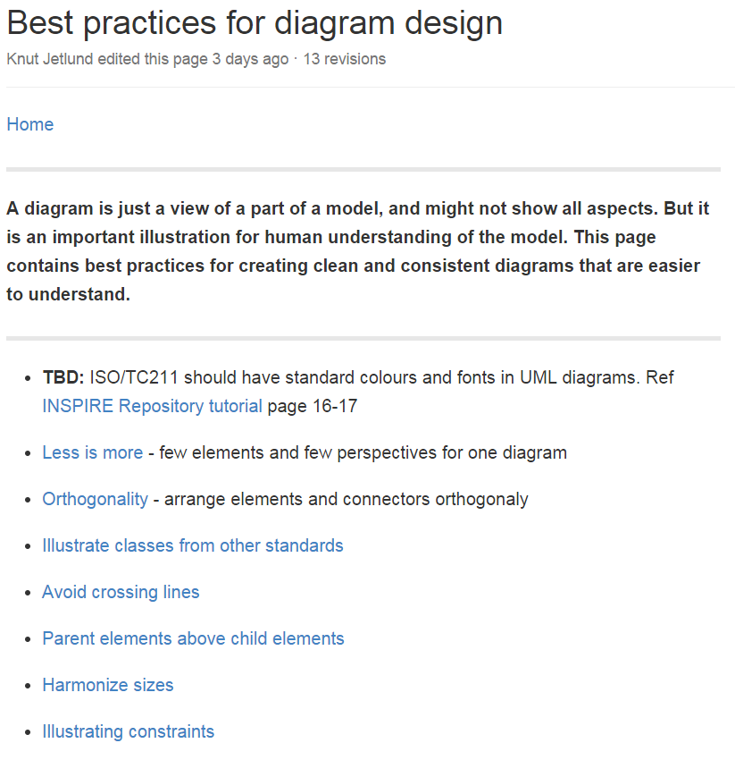
Diagram design
https://github.com/ISO-TC211/UML-Best-Practices/wiki/Best-practices-for-diagram-design
Notes:
The design of a diagram is important for human readability. There are some basic best practices that we should follow to create clean and consistent diagrams, and I have been working with describing them on the wiki. Several of them are inspired by a belgian blogger – Geert Beelkens, who has written some blog posts on best practices for UML modelling. Probalby, there will be added more recomendations based on discussions in the group.

Slide 12
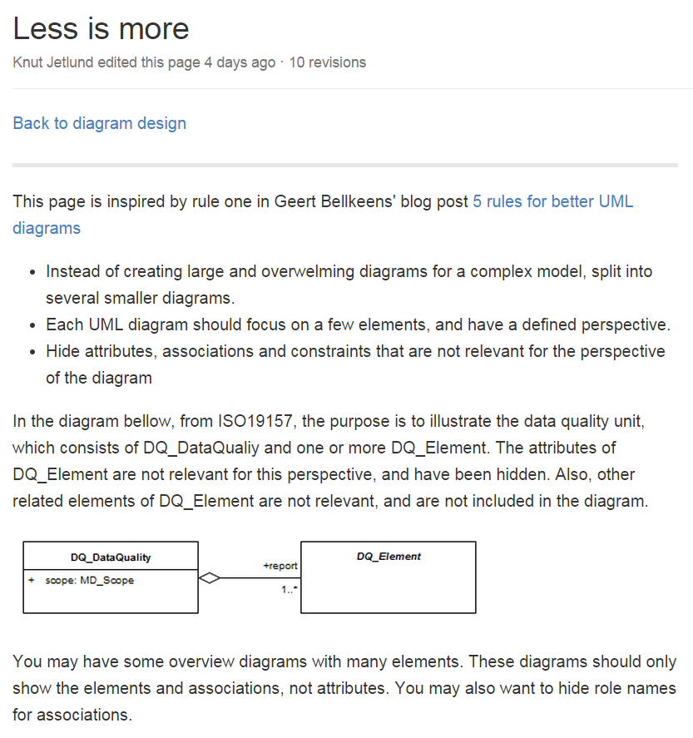
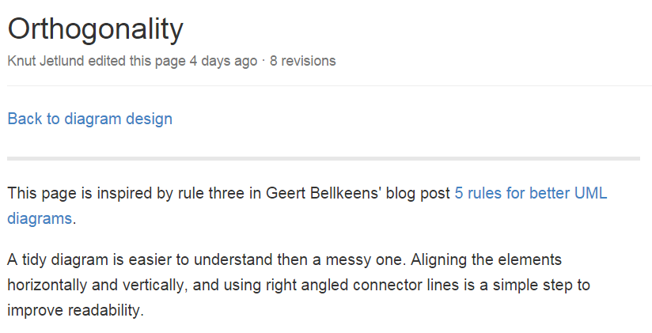
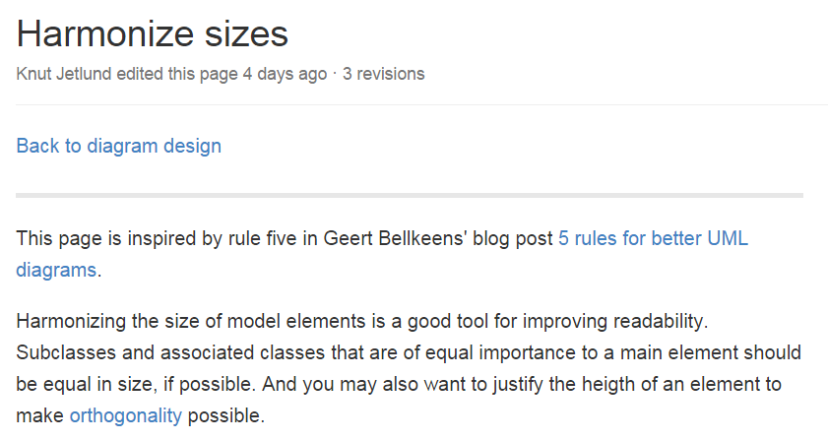
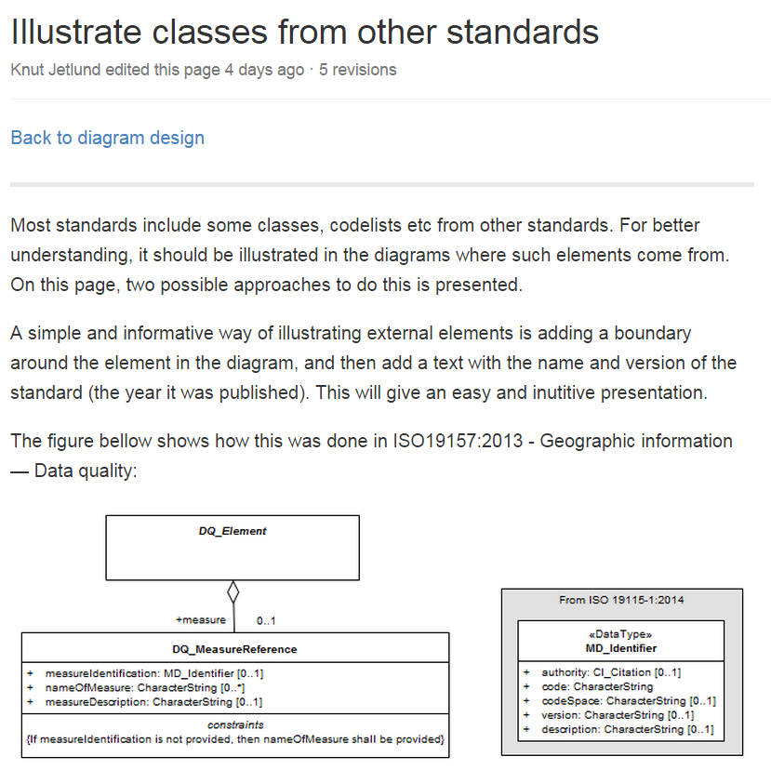
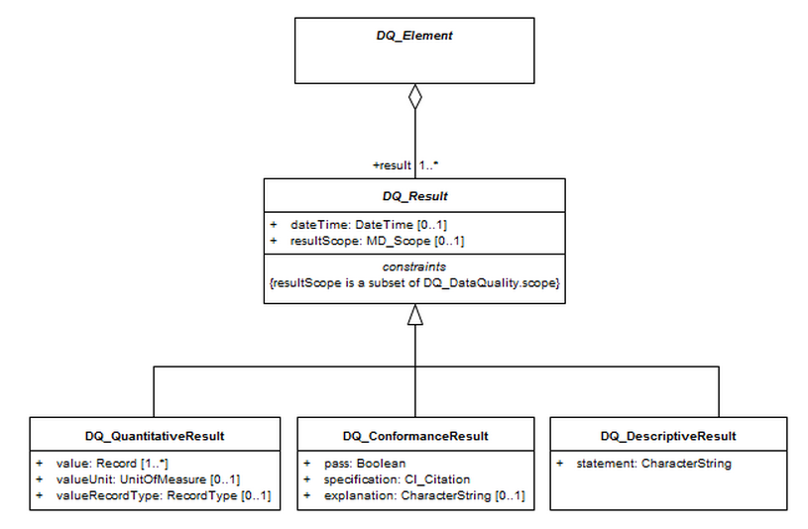
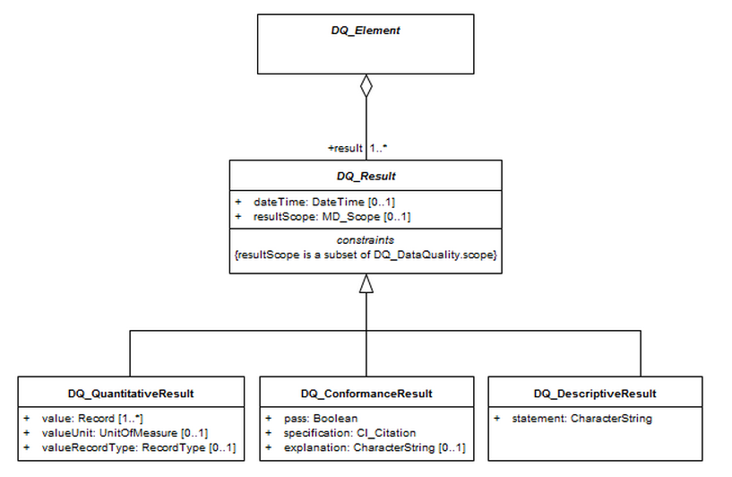
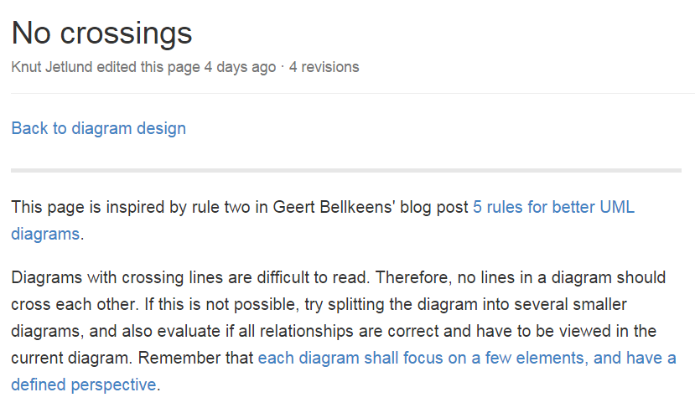
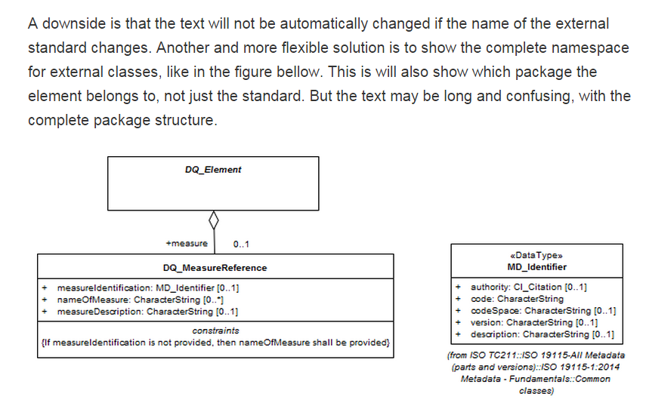
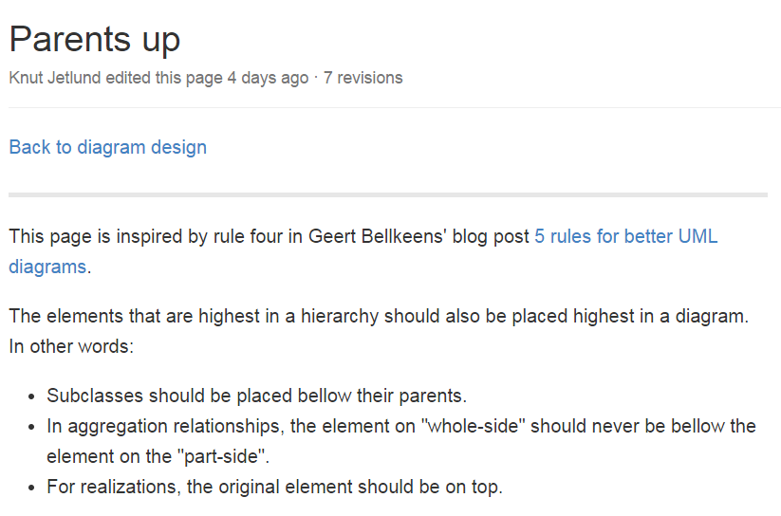
Notes:
A quick presentation of the recomendations for diagram design.

Slide 13
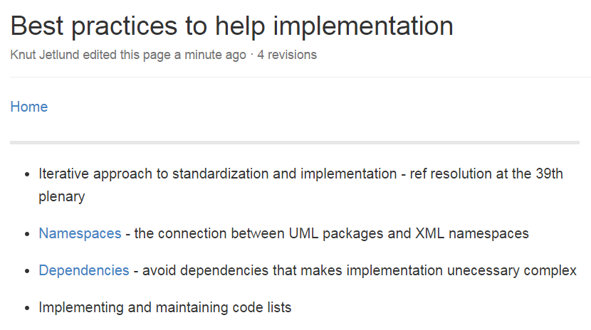
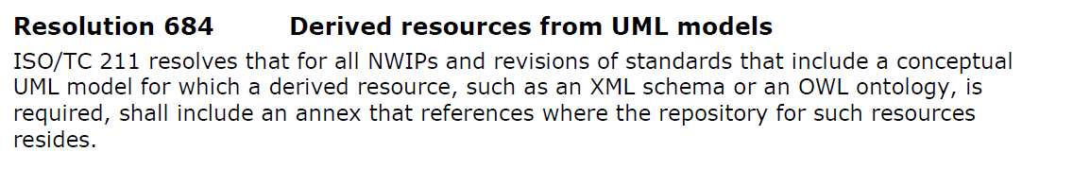
Implementation issues
https://github.com/ISO-TC211/UML-Best-Practices/wiki/Best-practices-to-help-implementation
Notes:
Finaly, we have some best practices that we should follow to prepare the models for implementation. These are very close related to the rules and recomendations for modelling. The work on creating an XML implementation of 19115 (metadata) has identified some important issues that we need to consider: The connection between namespaces and packages, and heavy dependencies that make implementation unessecary complex.
Most important: The implementations should be tested during the development of the standard – an iterative apporach, and the implementation schemas should be available at the same time that the standard is released. This is also stated through a resolution from the ISO/TC211 plenary in China last November.

Slide 14
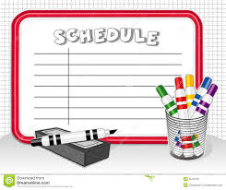
Timeline
ISO/TC211 Ad hoc group on Best practices for UML
What:
Describe specific topics on the wiki site
Start with base topics, go into details later
How:
Discussion forum on Livelink
Web meetings when needed
Physical meeting in Southampton in June 2015 (ISO/TC211 meeting week)
Next:
We should continue the work up to the next meeting week in October/November 2015, probably longer
Notes:
A few final words on the further work in the group.

Slide 15

Questions?
?

